Slide 1
Revature India Pvt. Ltd.
Week 4- Team project
Student database & query
Team :
Piyush Goyal
Aysha Musktesar
Surya Dev Gedela
Bhawana Priya
GitHub :- https://github.com/piyushgoyal1620/Student-Project
Submitted To:
Mr. Prinshsu Verma
(Big- data specialist at Revature )

Slide 2
Contents
What is ORC.
Need of ORC.
Master table in ORC.
Fetch the all data from Master to other tables.
Perform mainly update operation.
Enter new record and update this record to the respective tables.

Slide 3
ORC
The Optimized Row Columnar (ORC) file format provides a highly efficient way to store Hive data. It was designed to overcome limitations of the other Hive file formats. Using ORC files improves performance when Hive is reading, writing, and processing data.
a single file as the output of each task, which reduces the NameNode's load.
block-mode compression based on data type
run-length encoding for integer columns
dictionary encoding for string columns

Slide 4
ACID
Acid properties for table in hive:-
set hive.support.concurrency = true;
set hive.enforce.bucketing = true;
set hive.exec.dynamic.partition.mode = nonstrict;
set hive.txn.manager=org.apache.hadoop.hive.ql.lockmgr.DbTxnManager;
set hive.compactor.initiator.on = true;

Slide 5
Why ORC?
reason why we create extra temp table to transfer data into master table:-
It is not possible to directly load a text file into a ORC table. Steps to load data into ORC file format in hive:
1.Create one normal table using textFile format.
2.Load the data normally into this table.
3.Create one table with the schema of the expected results of your normal hive table using stored as orcfile.
4.Insert/overwrite query to copy the data from textFile table to orcfile table.

Slide 6
Using pig
Not Implemented
you can use Pig to load CSV data directly from HDFS. You have to define the schema for the CSV within the Pig script and you can write the data to a Hive ORC table. Be aware that the Hive ORC table must be created before you can write to it with Pig.

Slide 7
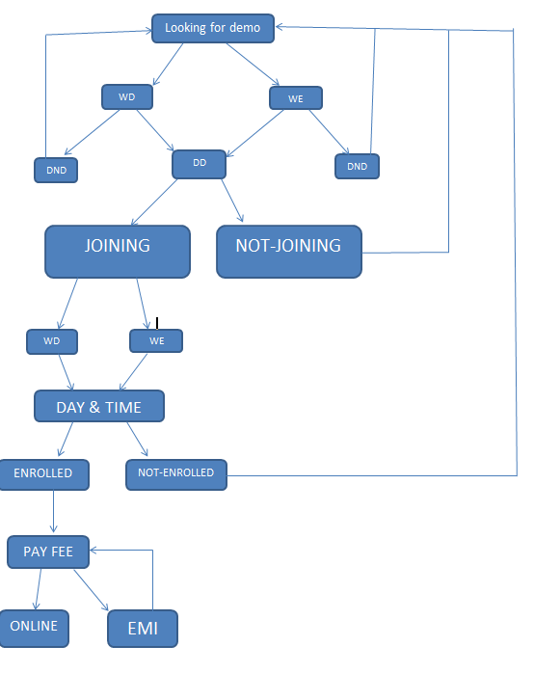
Work Flow
This is the Work Flow of our Project.

Slide 8
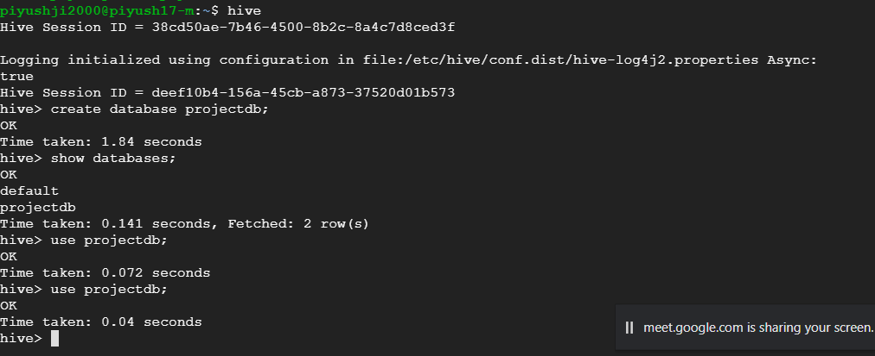
Create database

Slide 9
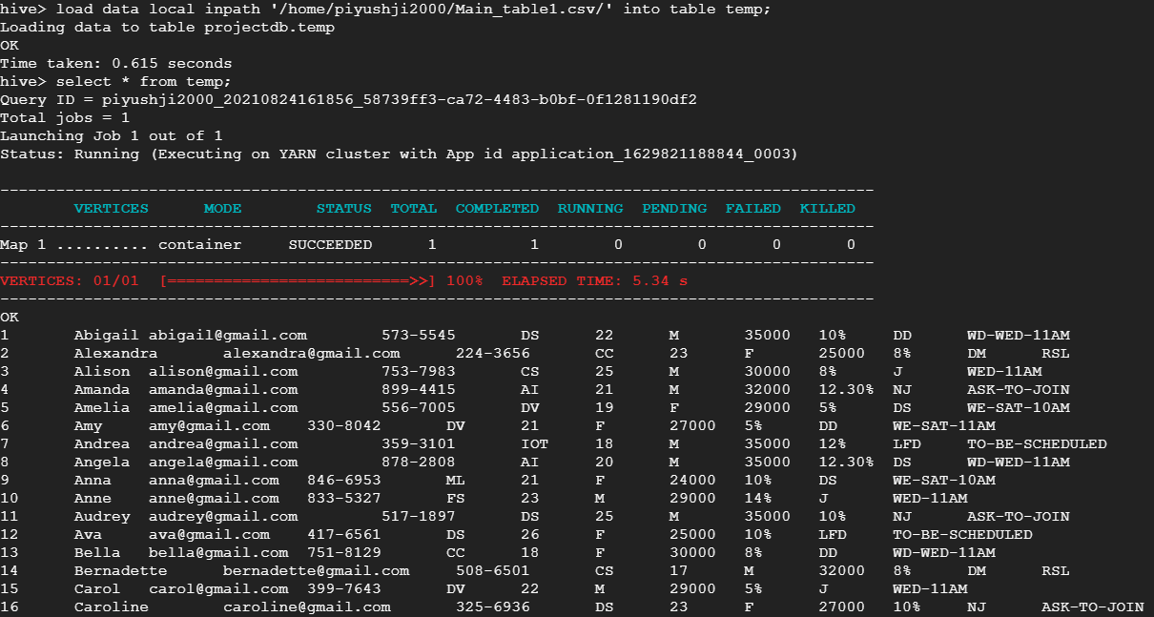
Create the table and load the data

Slide 10
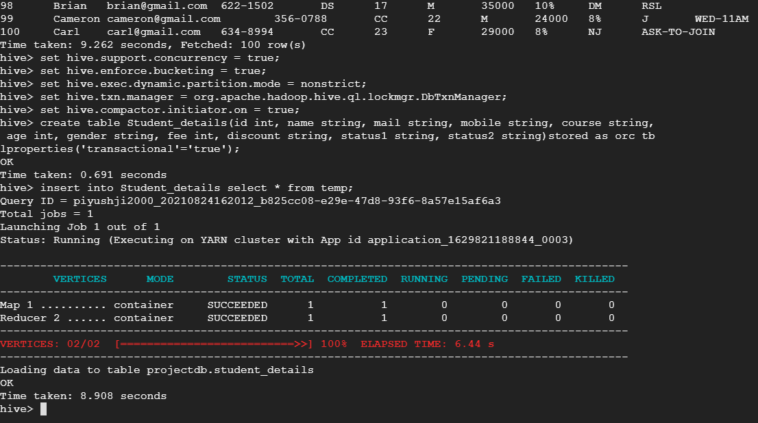
Apply ACID and create ORC table

Slide 11
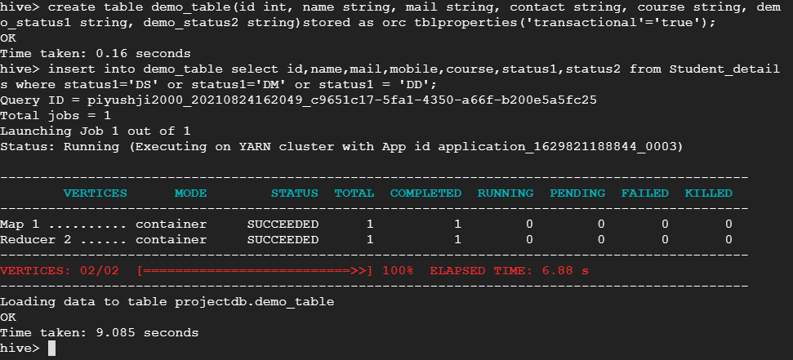
Create demo and load the data from master table

Slide 12
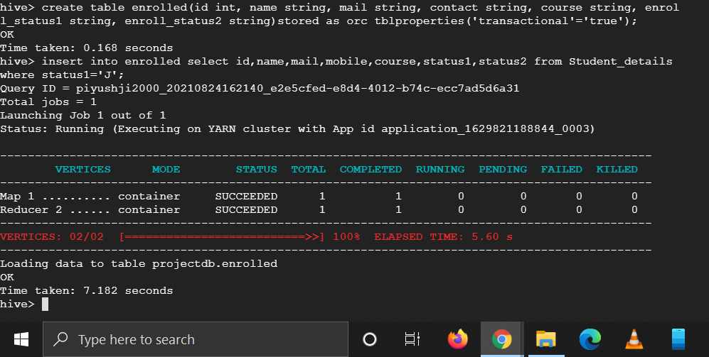
Create enrolled table and load the data from master table

Slide 13
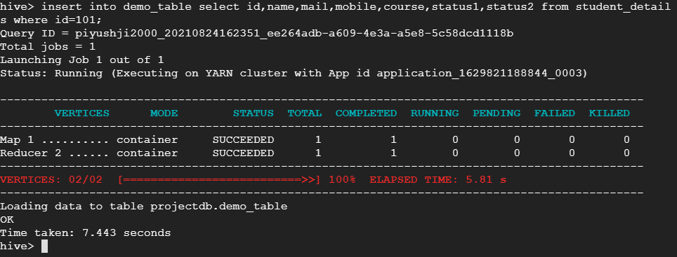
Insert the data into paymet_details

Slide 14
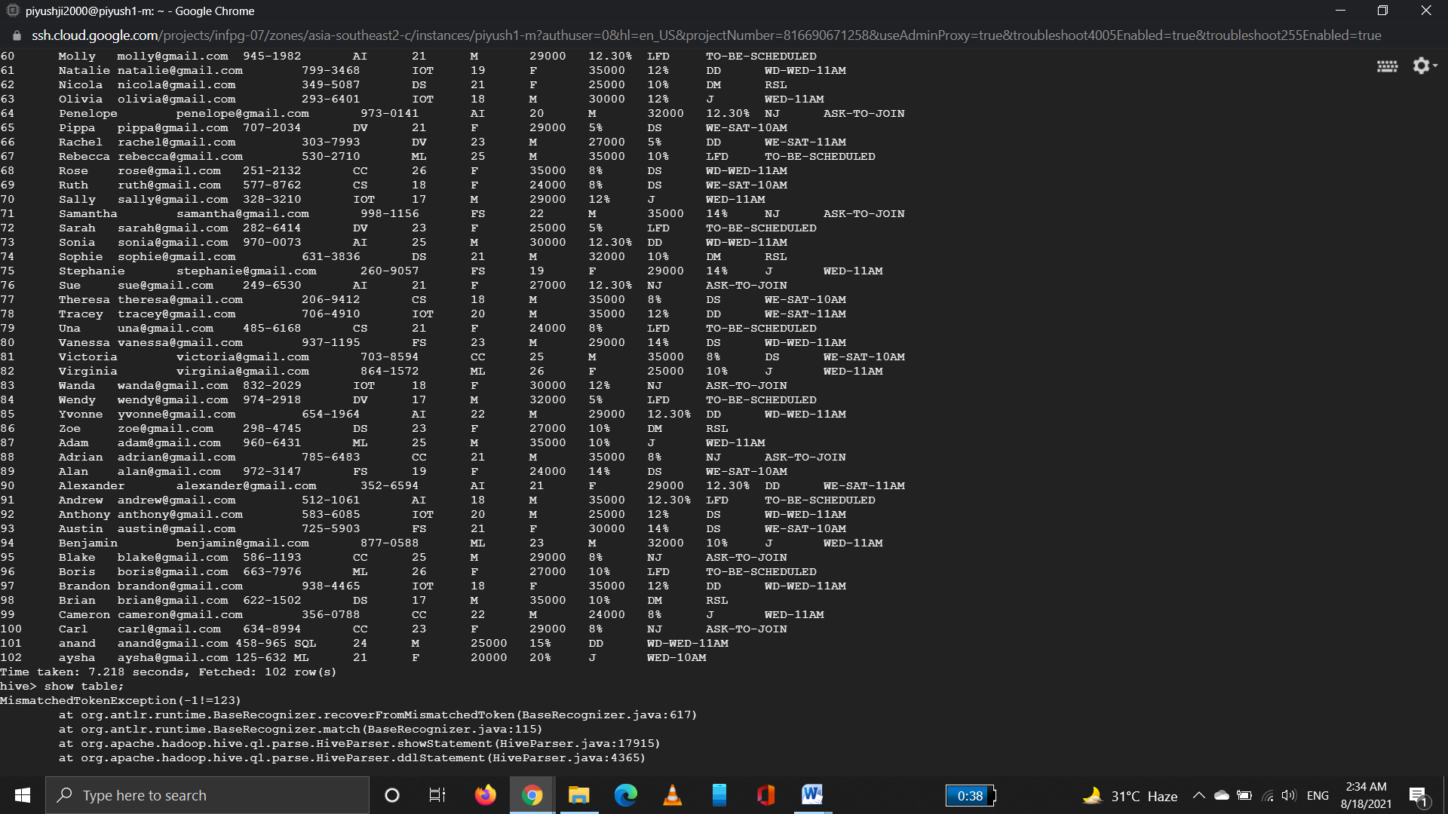
Update record
insert into student_details values(101,'anand','anand@gmail.com','458-965','SQL',24,'M',25000,'15%','DD','WD-WED-11AM'),(102,'aysha','aysha@gmail.com','125-632','ML',21,'F',20000,'20%','J','WED-10AM');

Slide 15
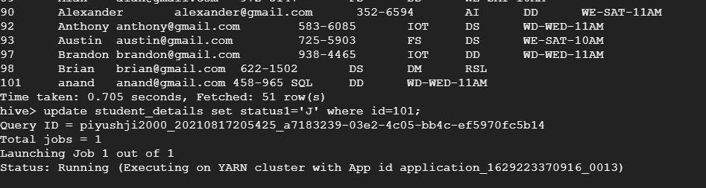
Update data into demo_table;
insert into demo_table select id,name,mail,mobile,course,status1,status2 from student_details where id=101;

Slide 16
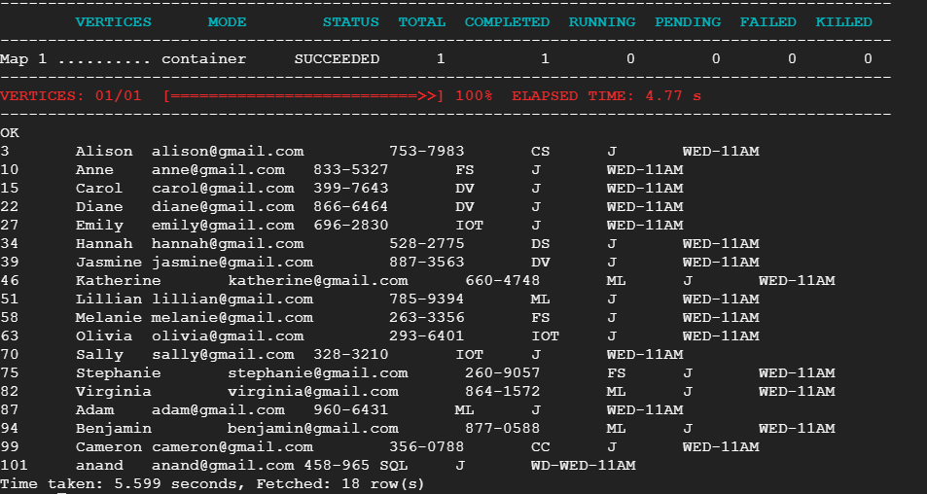
Update student From DD to Joined
update student_details set status1='J' where id=101;

Slide 17
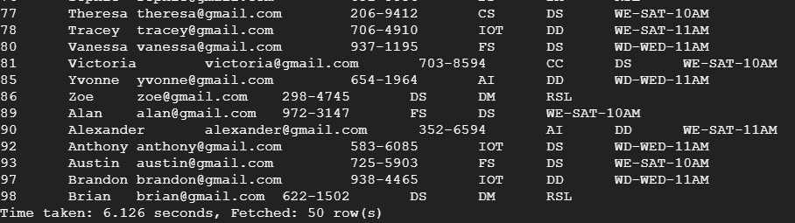
Delete in demo_table;
Data is reached at joined table so delete the data from demo_table;
delete from demo_table where id=101;

Slide 18
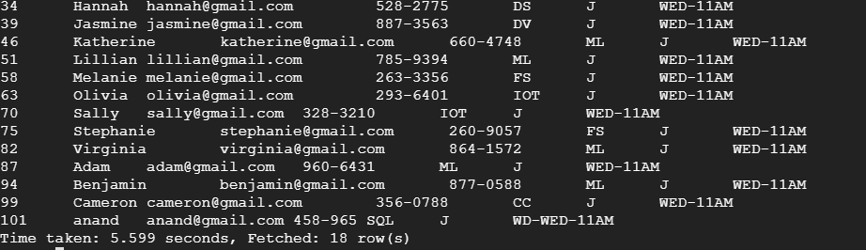
Insert the fee details in enrolled table;
Now student has joined our training.
insert into enrolled select id,name,mail,mobile,course,status1,status2 from student_details where id=101;

Slide 19
Thank you

